Slide 1
PANDAS
Python Data Analysis Library

Slide 2
DATA ANALYSIS : EXCELL

Slide 3
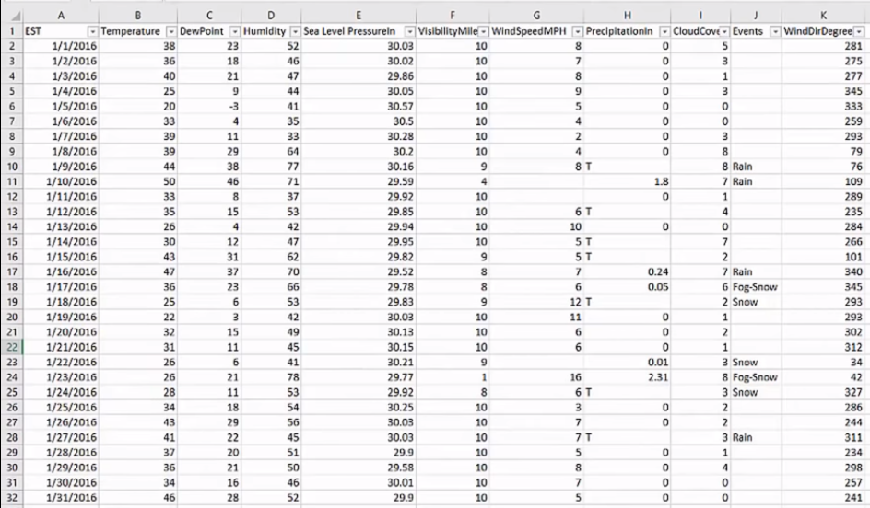

Slide 4
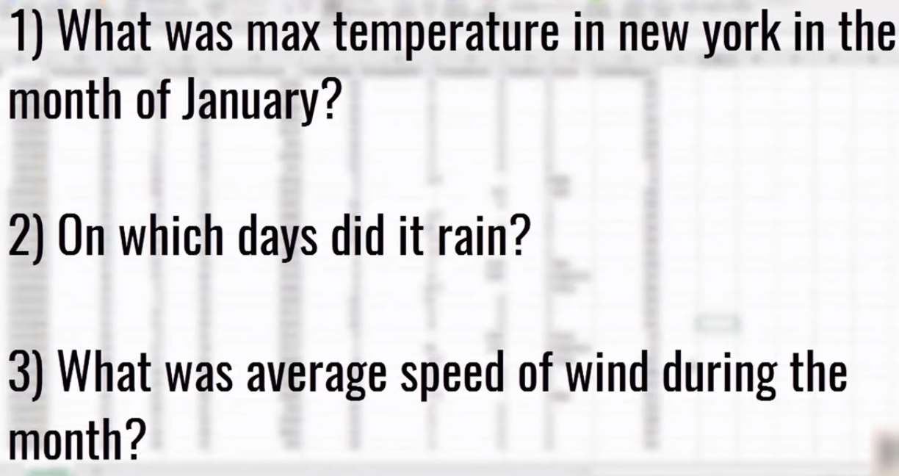
EXCEL :
When your data size is grows beyond some points. If you are dealing with millions & millions
of data points then it becomes harder to do data analysis in excel. Because,
It becomes slow
It doesn’t have necessary features or functionality that you will need the data at size.

Slide 5
DATA ANALYSIS : PYTHON

Slide 6
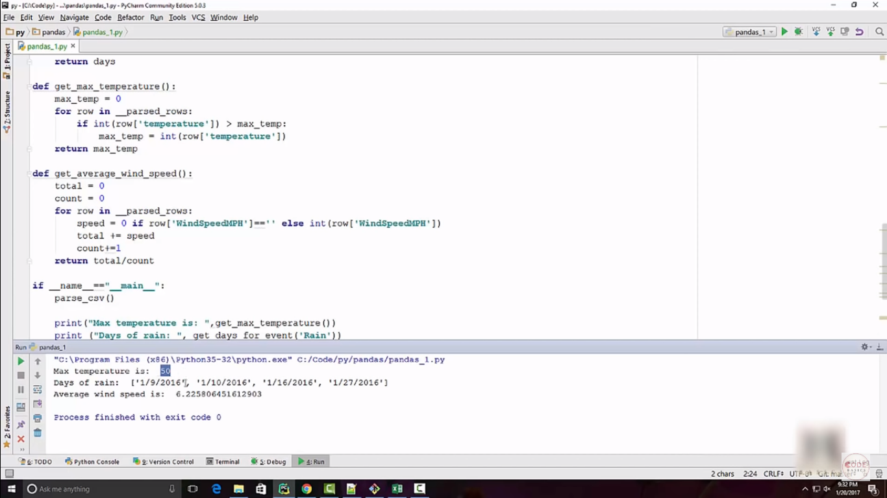

Slide 7
I have to spend quiet long time to write this code.
Code need to be test
Bugs
Whenever want to do some different kind of analysis, you have to write again code
(72 lines of code)
With PANDAS FRAMEWORK, we can do the same thing pretty easily by writing only few lines of code.

Slide 8
DATA ANALYSIS : PANDAS

Slide 9
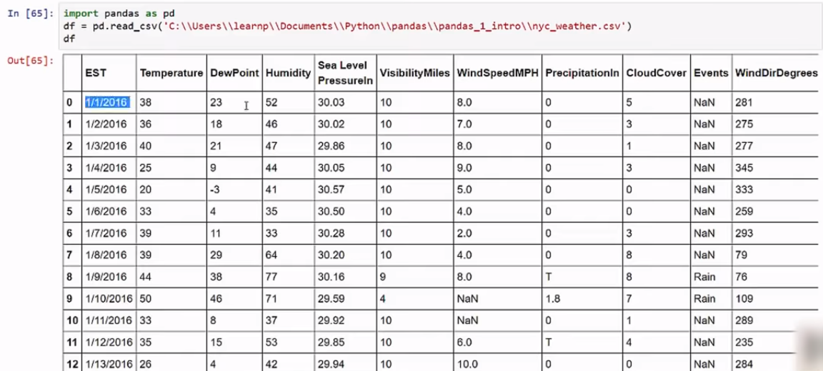
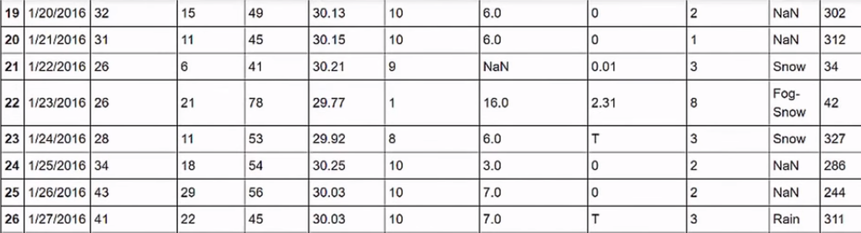

Slide 10
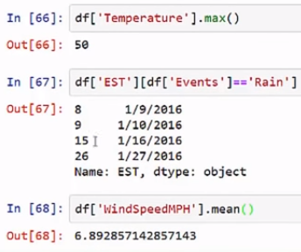
This difference because of NAN or blank
cell in excel as below slide
PANDAS
PYTHON

Slide 11
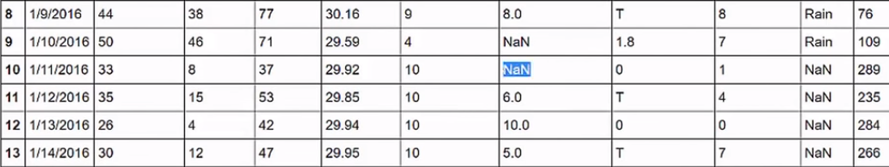
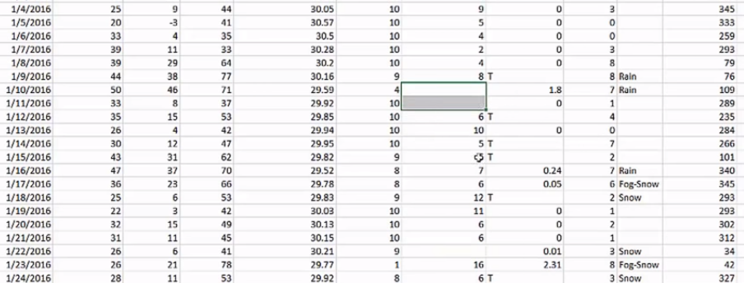

Slide 12



Slide 13
